Slide 1
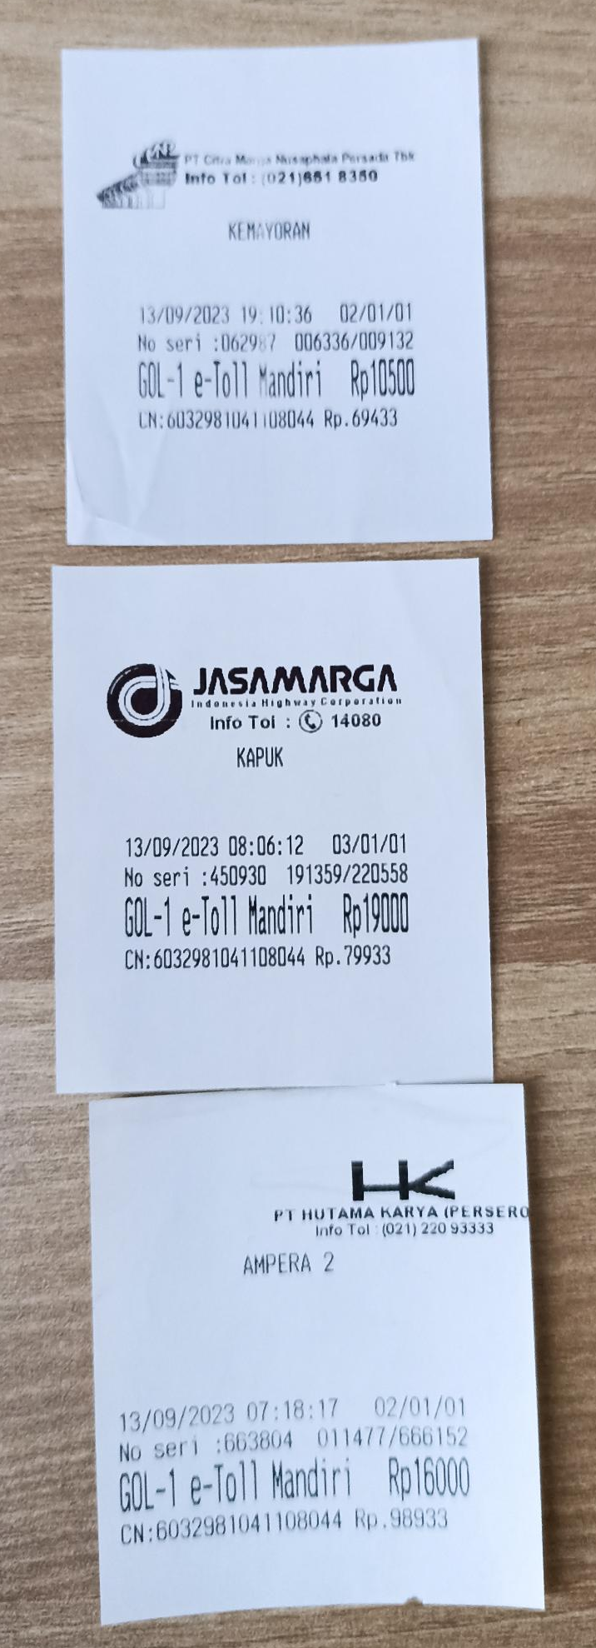
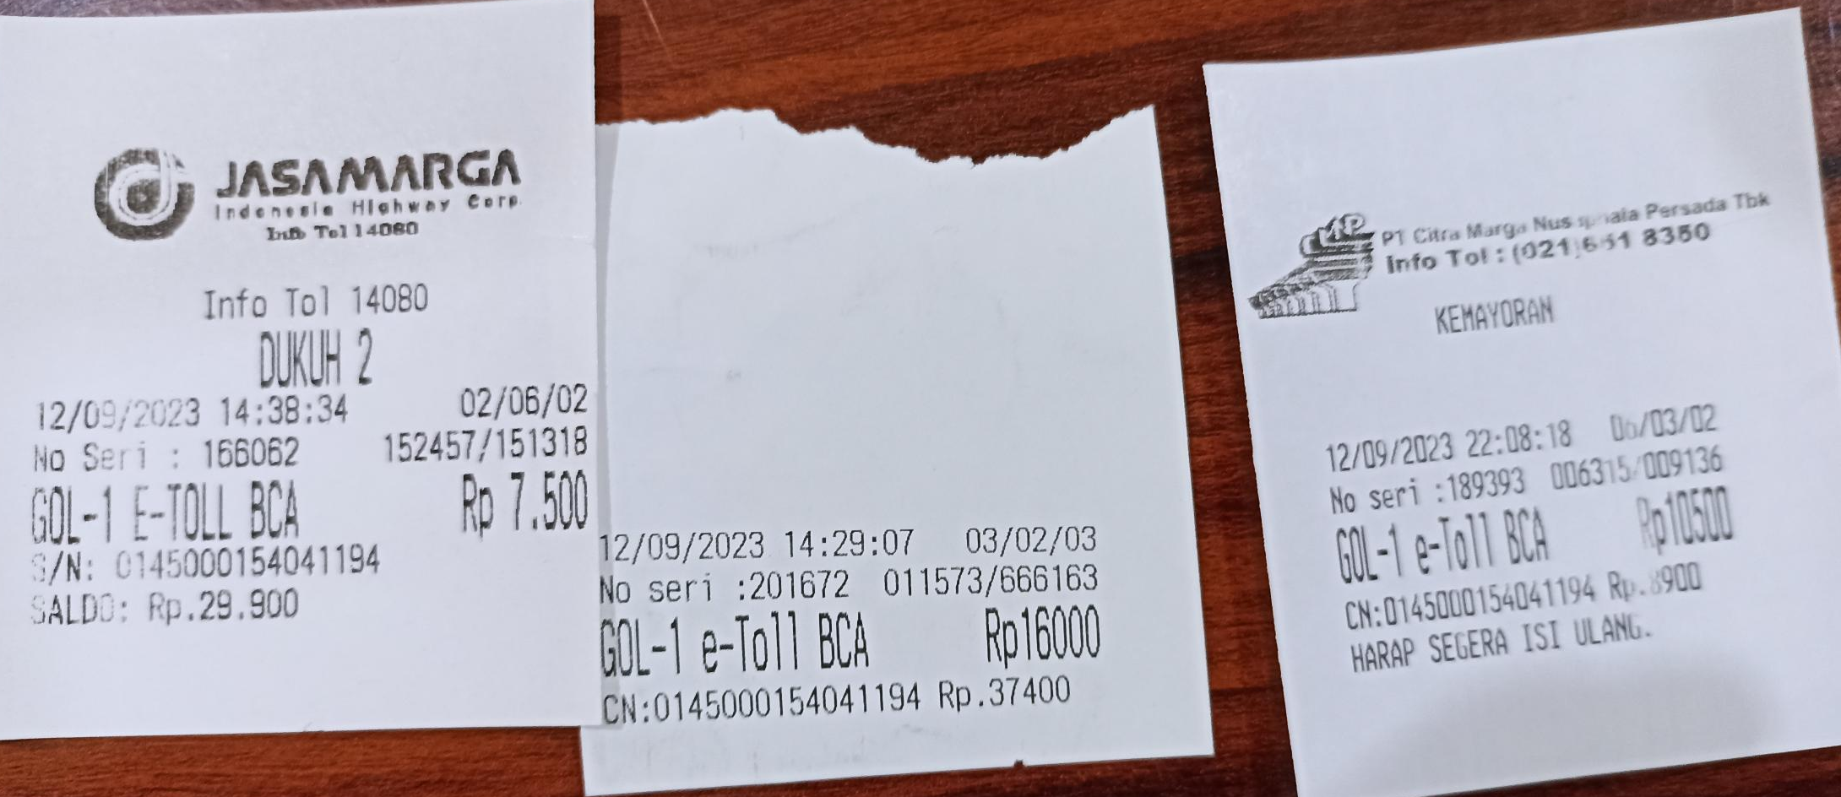
Mining Expo
Toll
13 Sept 2023
(45.500)
Mining Expo
Toll & Parking
12 Sept 2023
(79.500)

Slide 2
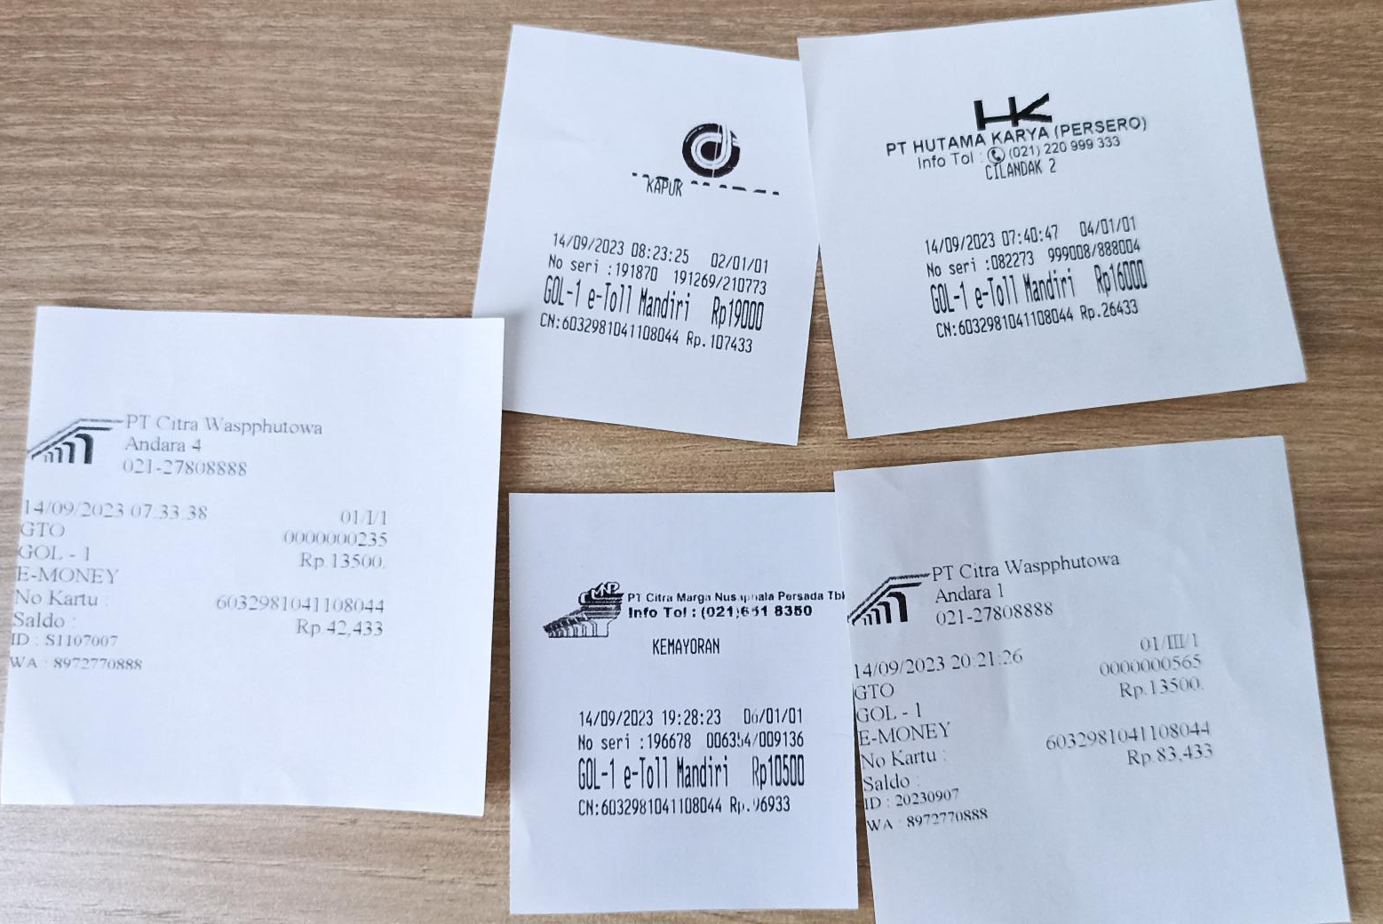
Mining Expo
Toll & Parking
14 Sept 2023
(72.500)
Mining Expo
Toll & Parking
15 Sept 2023
(72.500)

Slide 3
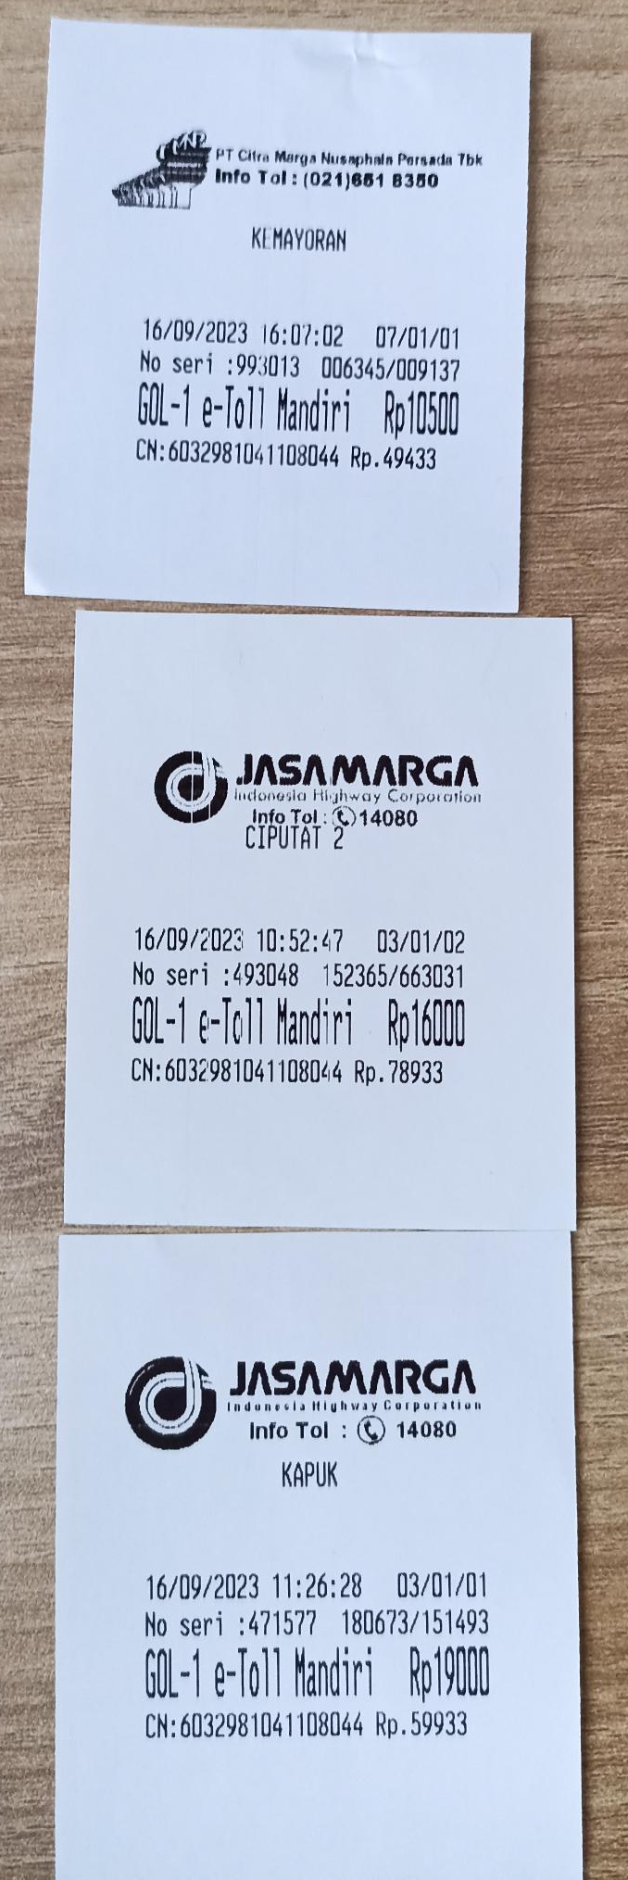
Mining Expo
Toll
16 Sept 2023
(45.500)

