Slide 1
Sustaining Profitability Growth Momentum
2023 Finance Summit
Denpasar, 08 May 2023
Dony Juaeni
Finance Dept. Batu Hijau
Confidentiality Status Yellow Green Red Non Confidential (choose one)
Notes:
CATATAN:
Confidentiality Status*
Red: Dokumen rahasia. Distribusi hanya ke pihak yang berwenang
Yellow: Distribusi internal di lingkup unit fungsional atau unit bisnis
Green: Distribusi internal di dalam lingkup perusahaan
Non-confidential: Distribusi bebas termasuk ke eksternal
*) Distribusi ke pihak lain harus dengan persetujuan pemilik dokumen

Slide 4
XXXX
X person
XXX (+XXXX XXXX XXXX)
Notes:
CATATAN:
Image Evacuation route ini diperuntukkan khusus untuk karyawan Head Office. Untuk lokasi lainnya, silakan dikonsultasikan dengan tim SHE.
Slide Emergency Evacuation Plan dibacakan pada saat meeting dilakukan secara tatap muka
Slide Protokol Keselamatan & Kesehatan dan Tata Laksana Virtual Meeting dibacakan pada saat meeting dilakukan secara tatap muka maupun virtual
--
Fire or emergency situation (English)
You will hear paging or fire alarm
Please do not panic
Floor warden or the Emergency Response Team (ERT) will guide you through the evacuation process
Do not come back to the building until further safety notification

Slide 5
Content : - Achievement 2022 - Driven to optimize sales - Cost monitoring - Positive Operating Cash Flow

Slide 6
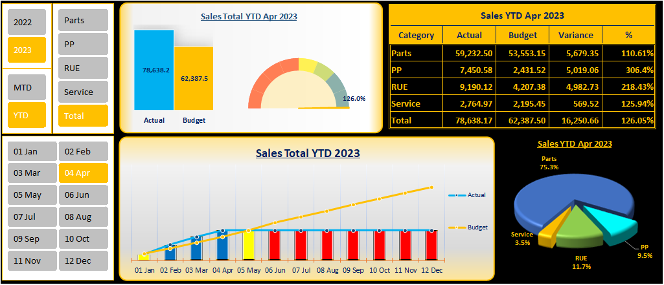
Driven to Optimize Sales by Target Revenue Monthly Setting

Slide 7
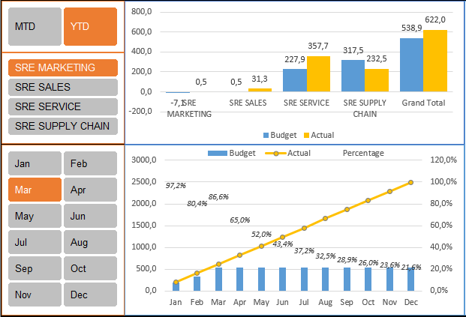
Cost Monitoring
SRE Supply chain

Slide 8
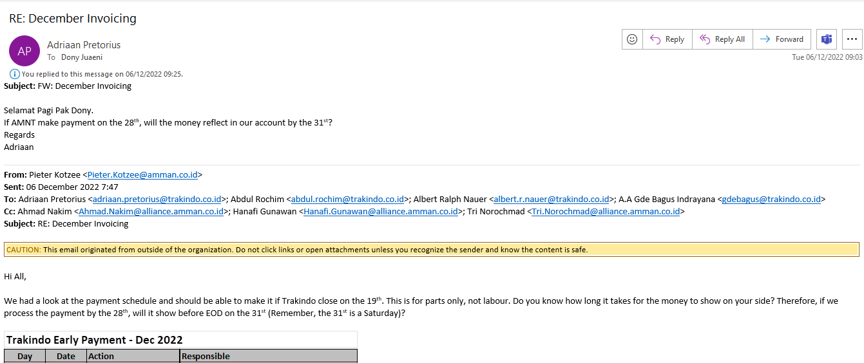
Positive cash flow by early invoicing and payment
SRE Supply chain

Slide 9
Color Scheme & Graphic Style Sample for Table

Slide 10
Color Scheme & Graphic Style Sample for Smart Art
Notes:
CATATAN:
Warna, bentuk, dan gaya grafis dapat diubah sesuai kebutuhan
--
Color, shape, and graphic styles are adjustable according to needs/requirements

Slide 11
Color Scheme & Graphic Style Sample for Column Chart
Notes:
CATATAN:
Warna, bentuk, dan gaya grafis dapat diubah sesuai kebutuhan
--
Color, shape, and graphic styles are adjustable according to needs/requirements

Slide 13
Content : - Achievement 2022 - Driven for optimize sales - Cost monitoring - Positive Operating Cash Flow - Initiative 2023

Slide 14
Dony Juaeni
Finance Department/Batu Hijau Division
Dony.juaeni@trakindo.co.id
The content of this presentation may not be used, duplicated or transmitted in any form without the written consent from PT Trakindo Utama.

