Slide 1
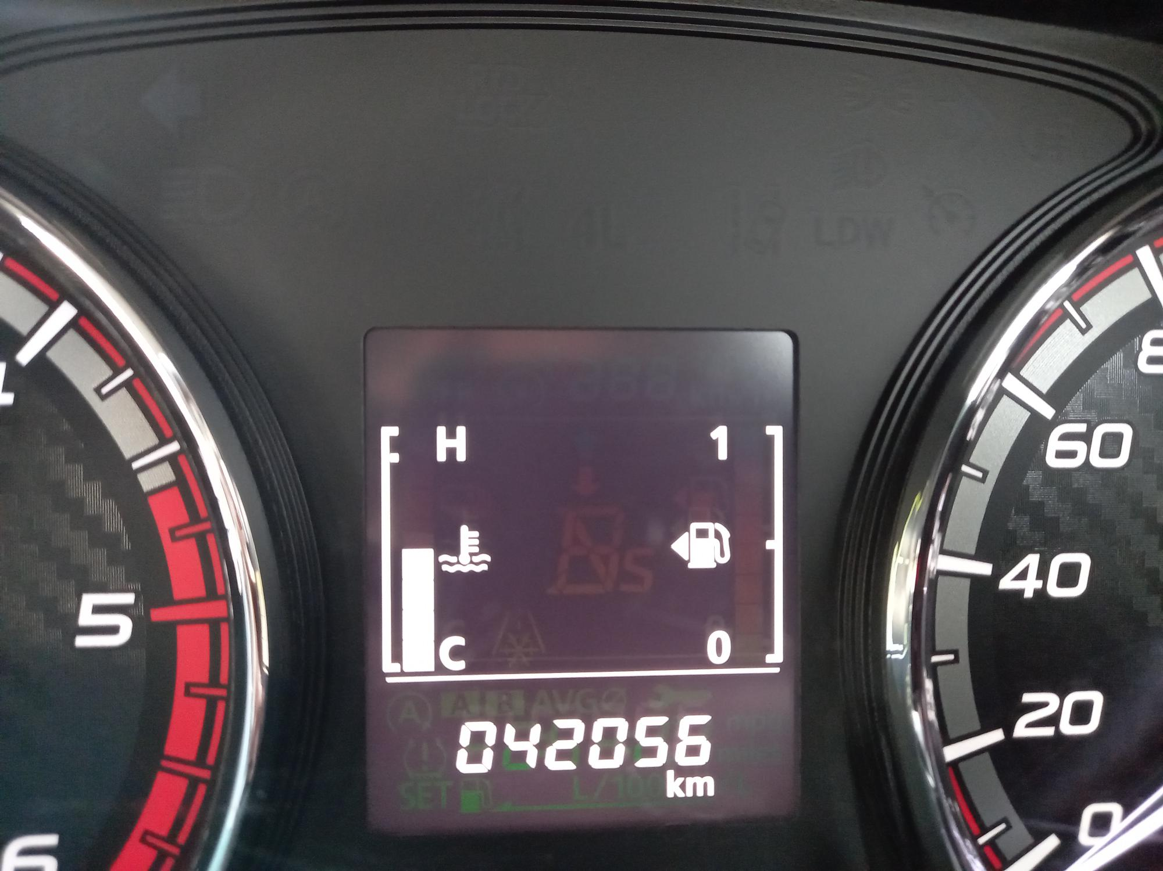
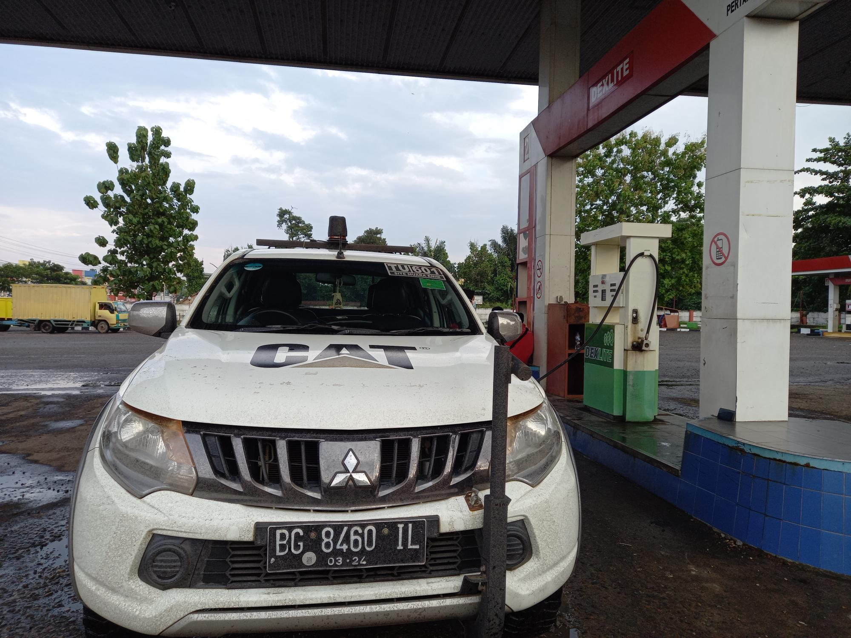
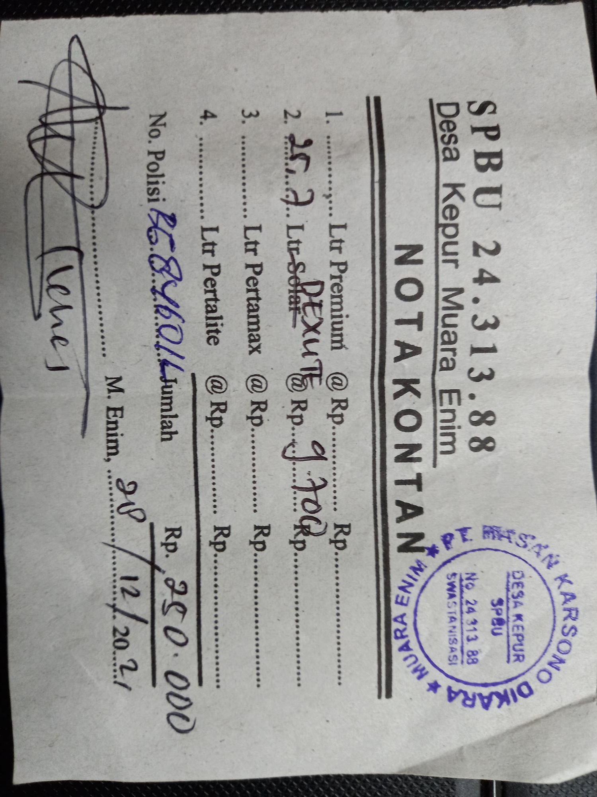
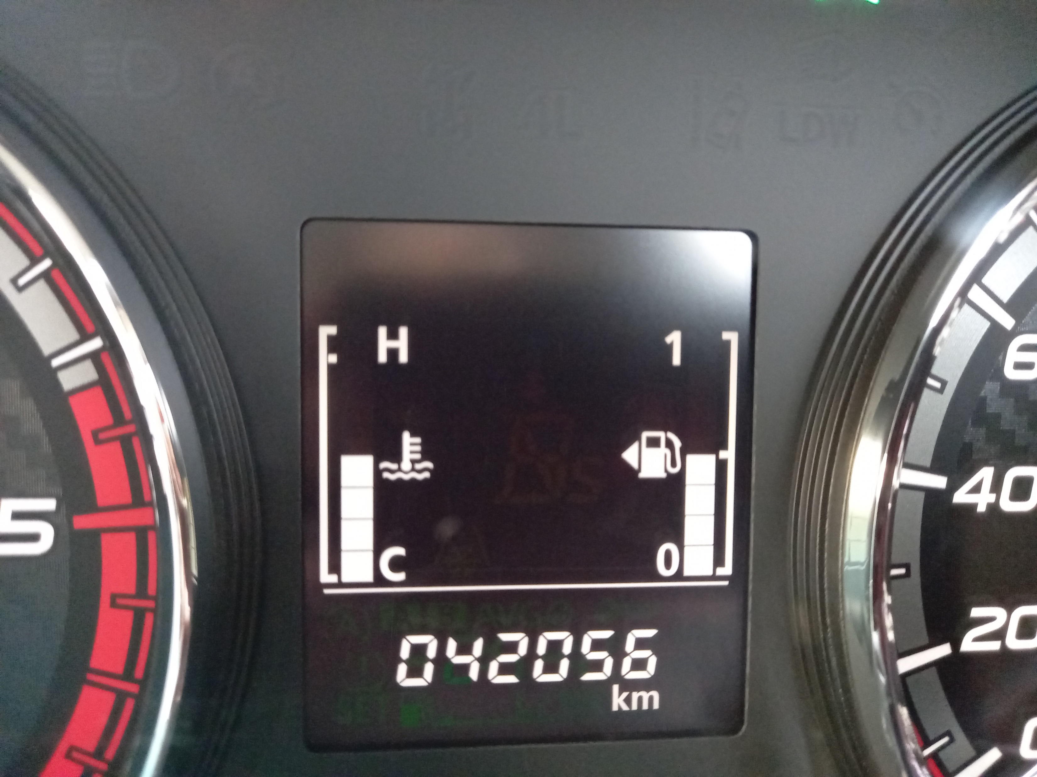
28 Dec 2021 by Dwi Nur IN PROCESS CLAIM
Odo: 42056
Liter Volume : 25.7
Price Amount : IDR 250,000
Fuel Type: Dexlite

Slide 2
ON PROCESS CLAIM

