Slide 1
336GC Observation Study
2 February 2021
Confidentiality Status
Notes:
ICC.ICC.SOP.001.R01
Tata Cara Pembuatan dan Pengendalian Dokumen
Procedures for Documents Development and Control
Status Dokumen
Non Confidential: dapat disebarluaskan kepada semua serta kepada pihak eksternal.
Green: hanya beredar sebatas lingkup perusahaan. Bila ingin disebarluaskan ke pihak eksternal harus mendapat persetujuan unit fungsional atau unit bisnis terkait yang menerbitkan dokumen.
Yellow: hanya beredar sebatas lingkup unit fungsional atau unit bisnis. Bila ingin disebarluaskan ke pihak lain, harus mendapat persetujuan dari unit fungsional atau unit bisnis terkait yang menerbitkan dokumen.
Red: hanya beredar pada pihak yang berwewenang saja (rahasia). Bila ingin disebarluaskan ke pihak lain harus mendapat persetujuan dari unit fungsional atau unit bisnis terkait yang menerbitkan dokumen.
Document Status
Non confidential: can be distributed to all including external document.
Green: limited to internal distribution only. If it needs to be distributed externally approval shall be obtained from related functional or business unit whom publish the document.
Yellow: distribution limited to functional unit or business unit only. If it needs to be distributed to others, approval shall be obtained from related functional or business unit whom publish the document.
Red: limited for distribution to authorized persons only. If it needs to be distributed to other persons, approval shall be obtained from related functional or business unit whom publish the document.

Slide 2
336GC Introduction
Target Customers:
Retail Mining contractors, rental houses, small mining customer
Overburden Removal (Material Density 1.5-1.6Tons/m³)
Coal Getting (Material Density 0.9-1 Tons/m³)
Activities:
Review 336GC GD Bucket 2.6CUM stability for Coal mining application thru observation study
Data collection to create local value story:
Productivity (tons/hours or tons/BCM)
Fuel Consumption (Litres/hours)
Time Lines:
5-9 April 2021

Slide 3
30-39 Tons Competitive Landscape 2020
Price (IDR)
Millions
2.6m³ Bucket
3.8%
2.3-2.4m³ Bucket
37.1%
29.7%
23.6%
2.1m³ Bucket
1.6m³ Bucket
Operating Weight (kg)

Slide 4
30-50 Tons Competitive Landscape 2020
Bucket
Price (IDR)
3.6m³
13.9%
39%
3.8m³
3.3%
75.9%
22.6%
3.2m³
2.6m³
37.1%
2.3-2.41m³
23.6%
29.7%
2.1m³
1.6m³
Operating Weight (kg)

Slide 5
THANK YOU

Slide 6
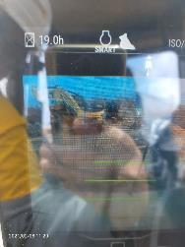
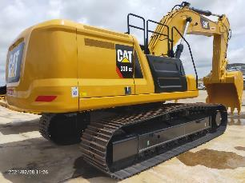
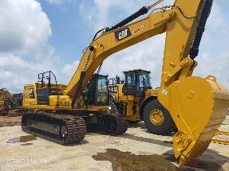
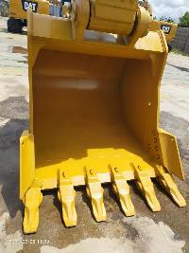
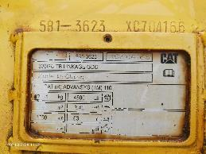
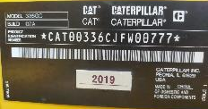
Machines Test

Slide 7
Marketing Intelligence and Product Manager

